Slide 1
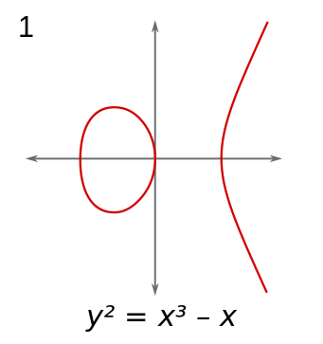
P1
P1
P2
P2
(P1+P2 ) +P3
P1+(P2+P3)
P1
P1
P3
P3
P2+P3
P1+P2
P1

Slide 2
∞
P1
P1
P1
P1 + ∞

Slide 3
∞
P1
P1
P1 + ∞
- P1

Slide 4
P1
P1
P2
P1
P1+P2
P1

Slide 5
P1
P1
P2
P1
P1+P2
P1

Slide 6





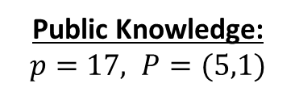

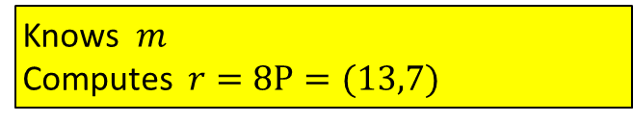
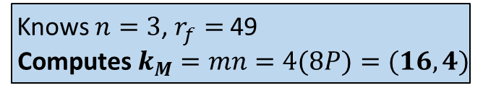
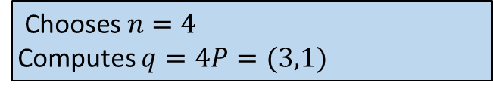
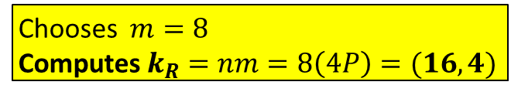
Public Knowledge: $p=17, P=(5,1)$
Moses
Rachael
Sends $q=(3,1)$
$\text{Chooses} n=4$
Computes $q=4P=(3,1)$
Chooses $m=8 \text{Computes}{ k}_{R}=nm=8\left(4P\right)=(16,4)$
Knows $n=3$, $r_{f}=$49
$$\text{Computes}{ k}_{M}=mn=4(8P)=(16,4)$$
Knows$m$ Computes $r=8P=(13,7)$
Sends $r=(13,7)$

Slide 7
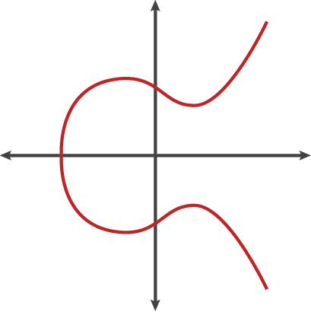
∞
All vertical lines on the EC reach the point of infinity
These two points of infinity are actually the same
∞

Slide 8
(P1 + P2)
P1
P2
(P1 + P2)’

Slide 9
P1
P1
P2
P2
(P1+P2 ) +P3
P1+(P2+P3)
P1
P1
P3
P3
P2+P3
P1+P2
P1

Slide 10
∞
∞
P1
P1
P1 + ∞
- P1
∞

Slide 11
∞
P1
P1
P1+∞
- P1

Slide 12
P1
P1
P2
P1
P1+P2
P1

Slide 13
P1
P1
P2
P1
P1+P2
P1

Slide 14
P1
P2
P1+P2

Slide 15
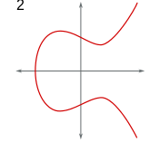
(P+P)’
P
P+P

Slide 16
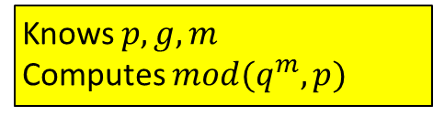

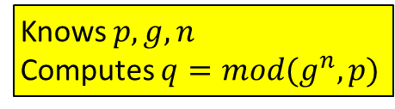
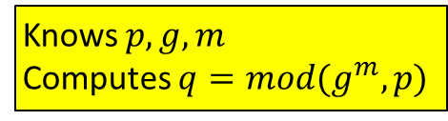
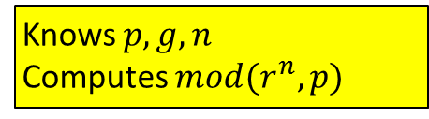

Moses
Rachael
sends
Knows $p, g, n$
Computes $q=mod(g^{n},p)$
Knows $p, g, m$
Computes $mod(q^{m},p)$
Sends $q$
Moses
Rachael
sends
Knows $p, g, n$
Computes $mod(r^{n},p)$
Knows $p, g, m$
Computes $q=mod(g^{m},p)$
Sends $r$

Slide 17






$$mod(g^{n},p)$$
$$mod(g^{nf},p)$$
$$mod(g^{mf},p)$$
$$mod(g^{m},p)$$
Moses
Fred
Rachael

Slide 18
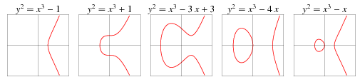

Slide 19




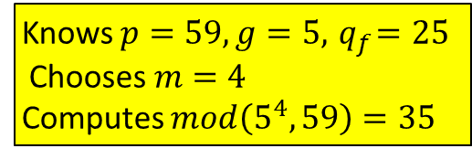
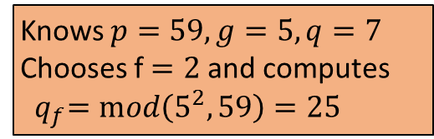
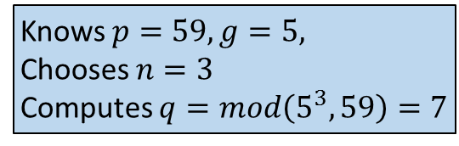
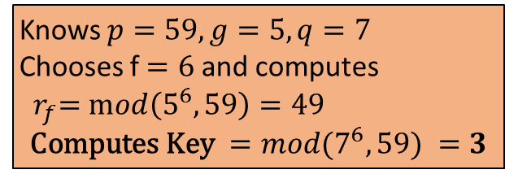
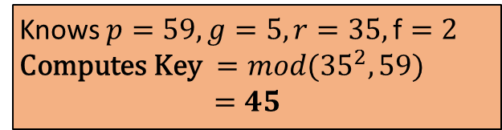
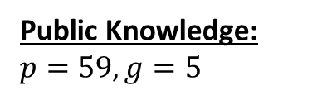
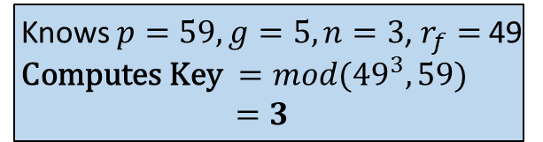

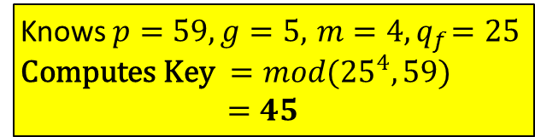

Public Knowledge: $p=59, g=5$
Moses
Fred
Knows $p=59, g=5, \text{Chooses} n=3$
Computes $q=mod\left(5^{3},59\right)=7$
Sends $q=7$
Knows $p=59, g=5,q=7$
Chooses f $=2$and computes
${ q}_{f}=mod\left(5^{2},59\right)=25$
Knows $p=59, g=5, n=3$, $r_{f}=$49
$\text{Computes} \text{Key} ={mod(49}^{3},59)$ $=3$
Knows $p=59, g=5,q=7$
Chooses f $=6$and computes
${ r}_{f}=mod\left(5^{6},59\right)=49$
$$\text{Computes} \text{Key} ={mod(7}^{6},59) =3$$
Sends $r_{f}=$49
Sends${ q}_{f}=25$
Knows $p=59, g=5,r=35,\text{f}=2$
$\text{Computes} \text{Key} ={mod(35}^{2},59)$ $=45$
Rachael
Sends $r=35$
Knows $p=59, g=5,{ m=4, q}_{f}=\text{25} \text{Computes} \text{Key} ={mod(25}^{4},59)$ $=45$
Knows $p=59, g=5,{ q}_{f}=25 \text{Chooses} m=4$
Computes $mod\left(5^{4},59\right)=35$

Slide 20
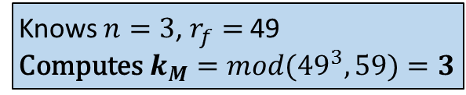
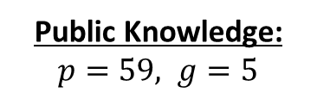



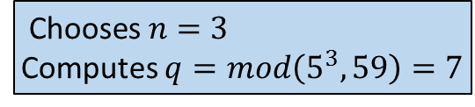
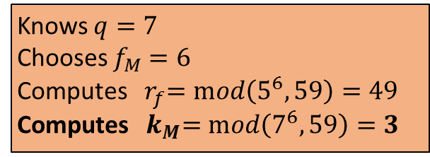

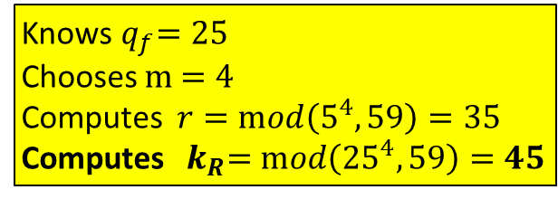
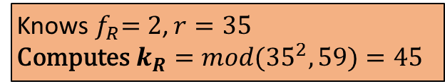
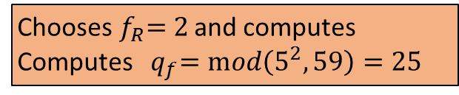
Public Knowledge: $p=59, g=5$
Moses
Fred
$\text{Chooses} n=3$
Computes $q=mod\left(5^{3},59\right)=7$
Sends $q=7$
Knows $q=7$
Chooses $f_{M}$ $=6$
Computes ${ r}_{f}=mod\left(5^{6},59\right)=49$
Computes ${ k}_{M}=mod\left(7^{6},59\right)=3$
Knows $n=3$, $r_{f}=$49
$\text{Computes}{ k}_{M}={mod(49}^{3},59)$ $=3$
Sends $r_{f}=$49
Rachael
Fred
Knows${ q}_{f}=25$
Chooses $m$ $=4$
Computes $r=mod\left(5^{4},59\right)=35$
Computes ${ k}_{R}=mod\left({25}^{4},59\right)=45$
Sends${ q}_{f}=25$
Chooses${ f}_{R}=2$ and computes
Computes ${ q}_{f}=mod\left(5^{2},59\right)=25$
Knows${ f}_{R}=2$, $r=35$
$\text{Computes}{ k}_{R}={mod(35}^{2},59)$ $=45$
Sends $r=35$

Slide 21
Public Knowledge: $p=59, g=5$
Moses
Fred
Knows $p=59, g=5, \text{Chooses} n=3$
Computes $q=mod\left(5^{3},59\right)=7$
Sends $q=7$
Knows $p=59, g=5,q=7$
Chooses f $=2$and computes
${ q}_{f}=mod\left(5^{2},59\right)=25$
Knows $p=59, g=5, n=3$, $r_{f}=$49
$\text{Computes} \text{Key} ={mod(49}^{3},59)$ $=3$
Knows $p=59, g=5,q=7$
Chooses f $=6$and computes
${ r}_{f}=mod\left(5^{6},59\right)=49$
$$\text{Computes} \text{Key} ={mod(7}^{6},59) =3$$
Sends $r_{f}=$49
Sends${ q}_{f}=25$
Knows $p=59, g=5,r=35,\text{f}=2$
$\text{Computes} \text{Key} ={mod(35}^{2},59)$ $=45$
Rachael
Sends $r=35$
Knows $p=59, g=5,{ m=4, q}_{f}=\text{25} \text{Computes} \text{Key} ={mod(25}^{4},59)$ $=45$
Knows $p=59, g=5,{ q}_{f}=25 \text{Chooses} m=4$
Computes $mod\left(5^{4},59\right)=35$

Slide 22

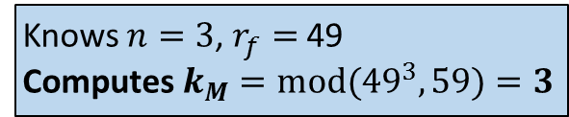
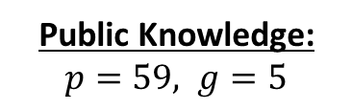
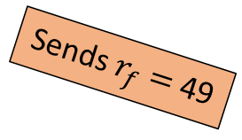
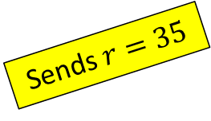
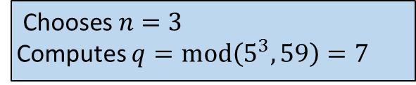
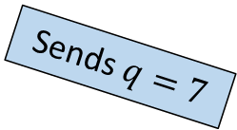
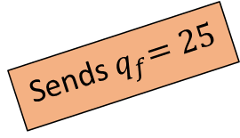
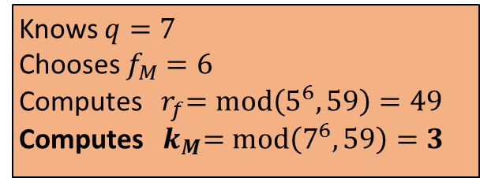
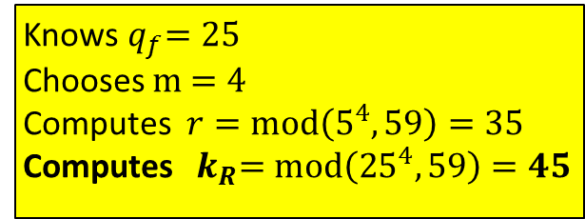
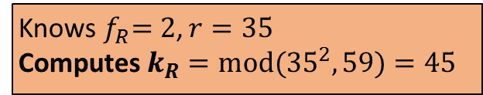
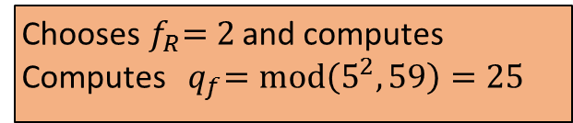
Public Knowledge: $p=59, g=5$
Moses
$\text{Chooses} n=3$
Computes $q=mod\left(5^{3},59\right)=7$
Fred
Knows $n=3$, $r_{f}=$49
$\text{Computes}{ k}_{M}={mod(49}^{3},59)$ $=3$
Sends $q=7$
Knows $q=7$
Chooses $f_{M}$ $=6$
Computes ${ r}_{f}=mod\left(5^{6},59\right)=49$
Computes ${ k}_{M}=mod\left(7^{6},59\right)=3$
Sends $r_{f}=$49
Chooses${ f}_{R}=2$ and computes
Computes ${ q}_{f}=mod\left(5^{2},59\right)=25$
Rachael
Sends${ q}_{f}=25$
Knows${ q}_{f}=25$
Chooses $m$ $=4$
Computes $r=mod\left(5^{4},59\right)=35$
Computes ${ k}_{R}=mod\left({25}^{4},59\right)=45$
Knows${ f}_{R}=2$, $r=35$
$\text{Computes}{ k}_{R}={mod(35}^{2},59)$ $=45$
Sends $r=35$

Slide 23




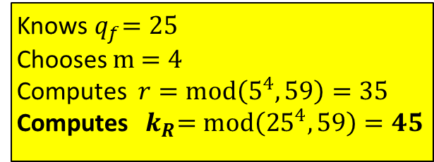
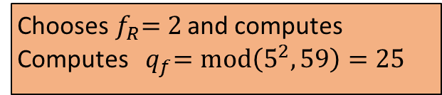
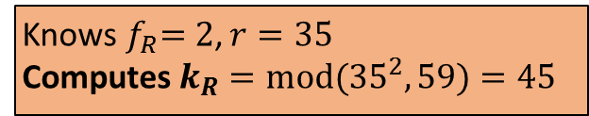


Public Knowledge: $p=59, g=5$
Moses
Sends $q=7$
$\text{Chooses} n=3$
Computes $q=mod\left(5^{3},59\right)=7$
Fred
Knows $n=3$, $r_{f}=$49
$\text{Computes}{ k}_{M}={mod(49}^{3},59)$ $=3$
Knows $q=7$
Chooses $f_{M}$ $=6$
Computes ${ r}_{f}=mod\left(5^{6},59\right)=49$
Computes ${ k}_{M}=mod\left(7^{6},59\right)=3$
Sends $r_{f}=$49
Sends${ q}_{f}=25$
Chooses${ f}_{R}=2$ and computes
Computes ${ q}_{f}=mod\left(5^{2},59\right)=25$
Rachael
Knows${ q}_{f}=25$
Chooses $m$ $=4$
Computes $r=mod\left(5^{4},59\right)=35$
Computes ${ k}_{R}=mod\left({25}^{4},59\right)=45$
Knows${ f}_{R}=2$, $r=35$
$\text{Computes}{ k}_{R}={mod(35}^{2},59)$ $=45$
Sends $r=35$

Slide 24
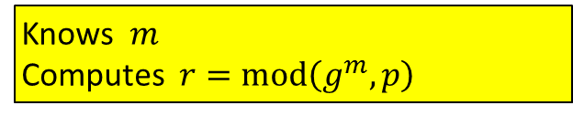

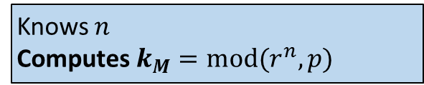
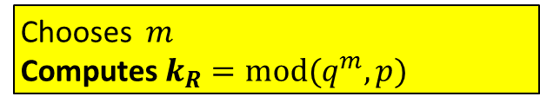
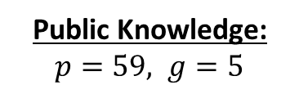
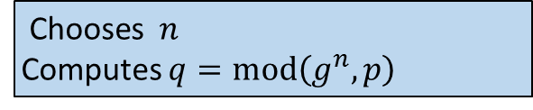

Public Knowledge: $p=59, g=5$
Moses
Rachael
Sends $q$
$\text{Chooses} n$
Computes $q=mod\left(g^{n},p\right)$
Chooses $m \text{Computes}{ k}_{R}={mod(q}^{m},p)$
Knows $n$ $\text{Computes}{ k}_{M}={mod(r}^{n},p)$
Knows$m$ Computes $r=mod\left(g^{m},p\right)$
Sends $r$

Slide 25

Moses
Fred
Rachael
Chooses n = 4
Chooses f = 5
Chooses m = 8
Computes n = 4P = (3,1)
Computes n = 4P = (3,1)
Computes m = 8P = (13,7)
Sends n = (3,1)
Receives
n = (3,1)
Receives n = (3,1)
Receives n = (13,7)
Receives m = (13,7)
Sends m = (13,7)
Computes mn = 4m = 4(8P) = (32P) = 13P = (16,4)
Computes nm = 8n = 8(4P) = (32P) = 13P = (16,4)

